Slide 1



SALE ANALYST
REPORT
16-Sep-2025
Sambath Seatky

Slide 2


PROJECT OBJECTIVE
Understanding Our Sales Performance
Analyzed sales data from the first half of the year to identify key trends and uncover strategic growth opportunities.

Slide 3
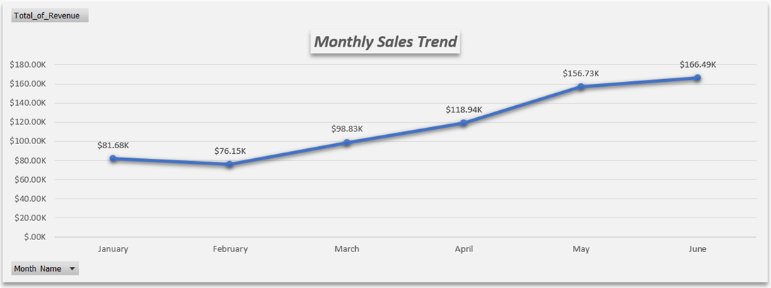
FINDING 1
THE BUSINESS IS GROWING RAPIDLY
The Big Picture: Remarkable Growth in 6 Months
Daily revenue has more than doubled since January, showing strong and accelerating business health

Slide 4
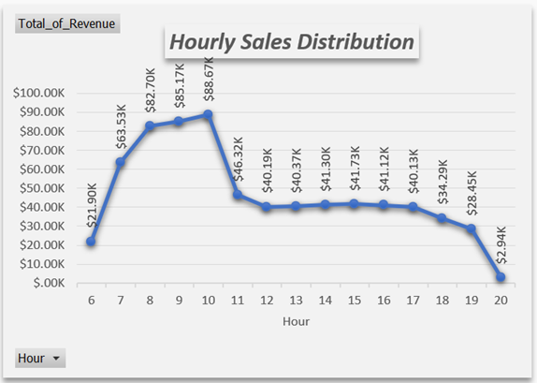
FINDING 2
THE MORNING RUSH DRIVES DAILY SALES
The Daily Rhythm: The Morning Rush is Our Engine
The 8-11 AM window is the most critical period, generating the highest concentration of daily revenue.

Slide 5
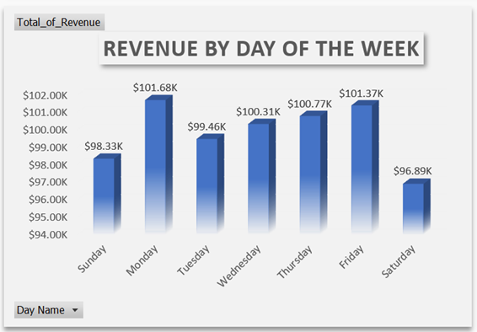
FINDING 3
A MAJOR WEEKEND OPPORTUNITY EXISTS
The Weekly Pattern: A Major Gap on Weekends
Saturday is the lowest-performing day, indicating a significant opportunity to attract a non-commuter audience.

Slide 6
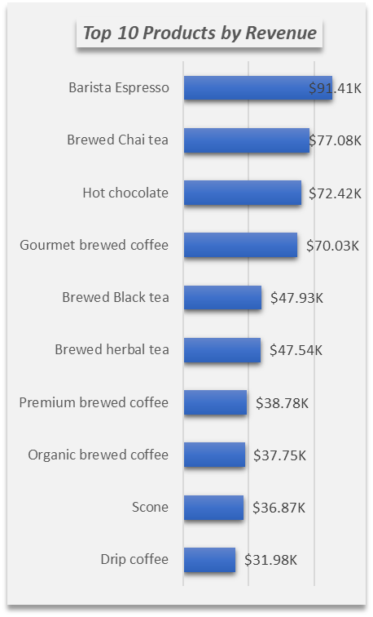
FINDING 4
CORE PRODUCTS ARE THE STARS
Product Insights: Our Superstar Products
A small group of core products, led by Barista Espresso and Brewed Chai Tea, are the key revenue drivers.

Slide 7
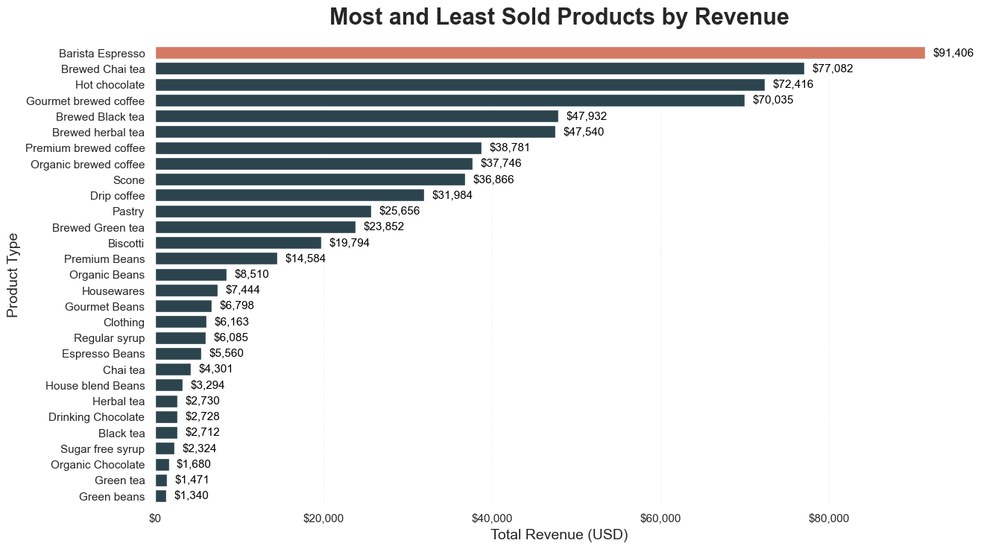
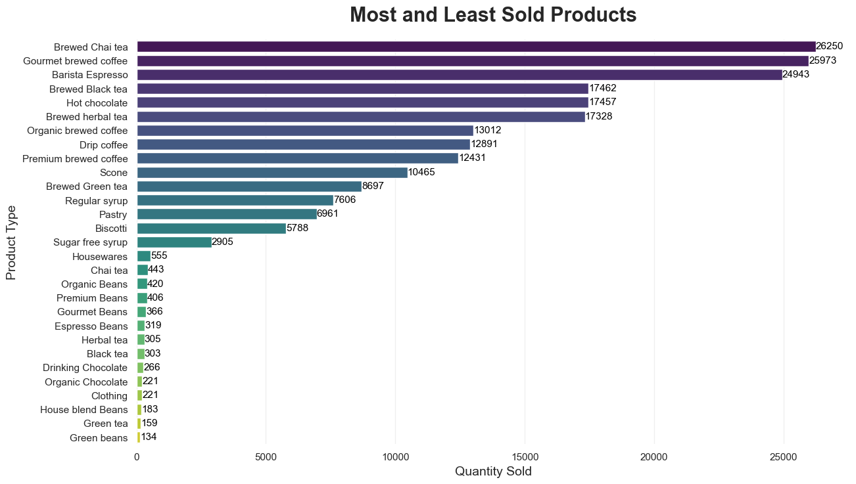
DEEPER INSIGHT
HIGH-VALUE VS. HIGH-VOLUME
Barista Espresso - Rank by Revenue: #1
Barista Espresso - Rank by Quantity Sold: #3
Despite not being the most-sold item, its higher price point makes it the top earner, highlighting the importance of promoting high-value products.

Slide 8

OUR TOP
RECOMMENDATIONS
🎯Target the Weekend Market: Launch a focused campaign to close the significant Saturday revenue gap.
⚙️Optimize the Morning Rush: Reinforce operations between 8-11 AM to maximize sales during the busiest hours.
☕Refine the Menu: Leverage data to promote high-value products and simplify the menu.

Slide 9


NEXT STEPS & DISCUSSION
LEVERAGING OUR INSIGHTS TO DRIVE STRATEGIC ACTION
Phase 1: Quick Wins (Q4 2025)
Implement Pilot Program: Launch a one-month trial of a "Saturday Special" promotion at one store to measure the direct impact on weekend sales and foot traffic.
Optimize Operations: Immediately adjust staffing schedules to reinforce the critical 8-11 AM weekday peak hours to maximize throughput.

Slide 10


NEXT STEPS & DISCUSSION
LEVERAGING OUR INSIGHTS TO DRIVE STRATEGIC ACTION
Phase 2: Strategic Review (Q1 2026)
Analyze Pilot Results: Conduct a full analysis of the "Saturday Special" pilot to determine its profitability and customer response.
Menu Refinement: Begin a review of the bottom 10% of products to identify candidates for removal, simplifying inventory and operations.

Slide 11


NEXT STEPS & DISCUSSION
LEVERAGING OUR INSIGHTS TO DRIVE STRATEGIC ACTION
Phase 3: Scale & Sustain (H1 2026)
Full Campaign Roll-out: Based on successful pilot data, launch a full weekend marketing campaign across all locations.
Investigate Growth Drivers: Dedicate resources to a deeper analysis of the initial H1 2025 growth to create a repeatable model for future success.

Slide 12

Q&A
THANK YOU.

